Slide 1
Back in My Rave
Eddie Waite, Connor Davey, Michael Ratcliffe, Harry Sollis, Pearce Jennings.
Notes:
Might ducks? idk

Slide 2
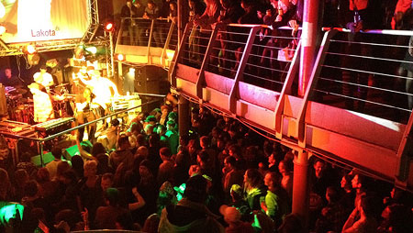
What is this Project?
A narrative driven, music experience
A VR experience that will throw the user into the music scenes of Bristol and the underground genres that came along with it over the years, (1970s-2010s) and how it has changed.
The user will have a choice of which music genre to experience inside a particular venue, which will be accompanied by an extract from a person that had first-hand experience with the venue/music scene.
Notes:
Harry
-
VR exploration
Underground Music in Birstol from the 1970’s through Modern day
The experience will allow users to control Their journey Through music, through Genre/Venue
Narrative lead experience
- It fits the format of ‘Best Seat in the House’ as well as ‘Revisualising Testimony’

Slide 3
Why have we chosen this idea?
To teach those who are unaware of the depth of Bristol's music scene
Demonstrate the change in music and culture that was inherent to each era
Give real life context, through first person accounts
Provide a nostalgic look back for those who did experience these events
Take the user on an experience that is visually entertaining and pleasing to listen to, that captures the essence of what being at these gigs/events was like
Notes:
Conk
- Nostalgia value is very important.
The main reasons we’ve chosen this project idea is to teach those that are unaware of the music scene in Bristol and how its changed over generations.
We will show the change in music and culture through out each era and along side it will be short monologues from people who experienced these scenes first hand.

Slide 4
Narrative
Will take the form of a guided tour for each scene
Linear experience relevant to the chosen music genre
Structured through a voiced narrator, accompanied by first-hand accounts
Notes:
Pearce

Slide 5
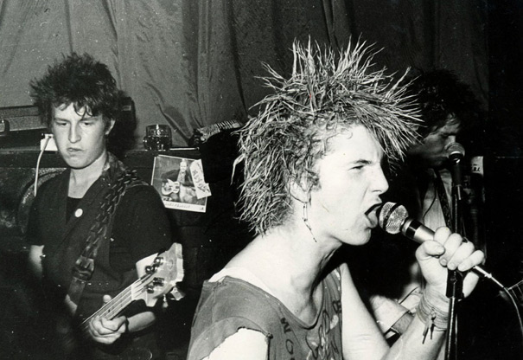
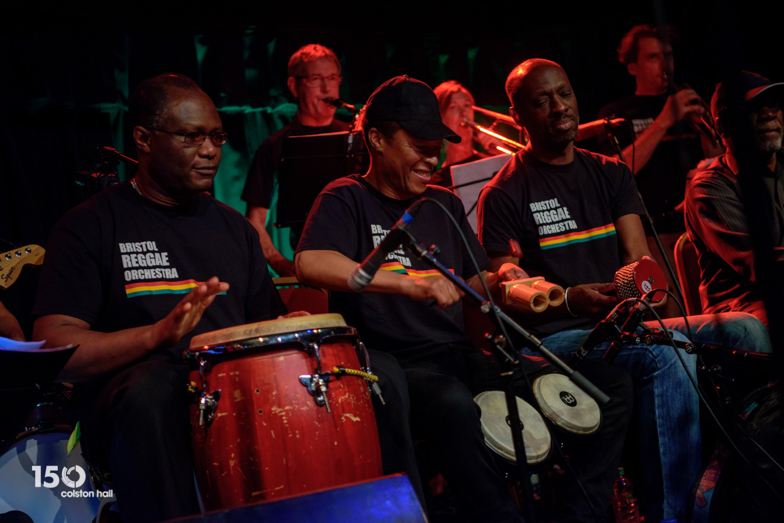
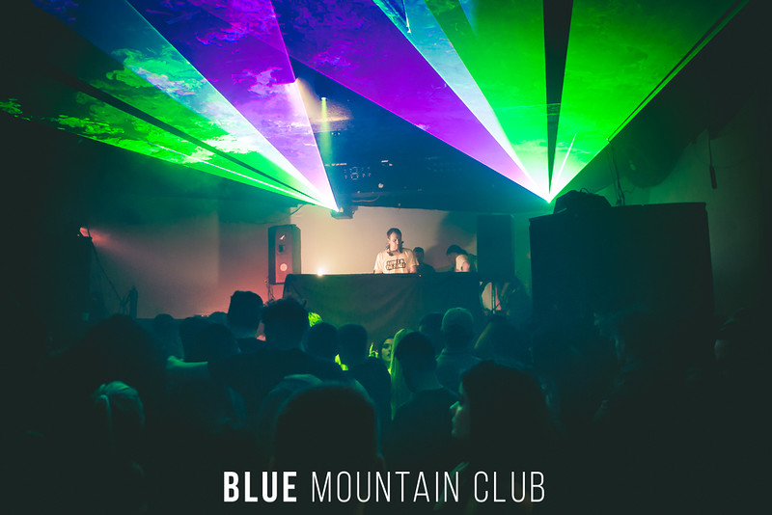
Music Genres
Punk
Reggae
Hip-hop
Rave Music
Notes:
Eddie
The main aim of the VR experience is to examine the underground genres that were prominent in Bristol from the 1970's up until today.
Punk – Punk was quite popular in Bristol in the 70's and 80's
Reggae – Reggae largely defined Bristol's music scene. It went on to influence a lot of the music that Bristol is well known for, such as drum and bass, and trip-hop
Trip Hop – Trip hop is a music genre which largely originated in Bristol with bands such as Massive Attack.
Rave Music – Rave music has been very prominent in Bristol's underground music scene, with music genres such as drum and base being largely popular to date.

Slide 6
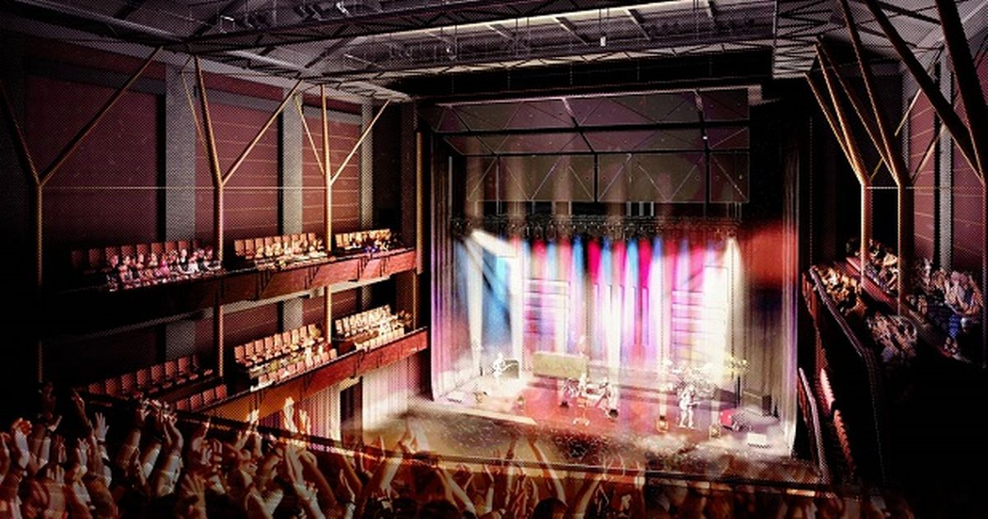
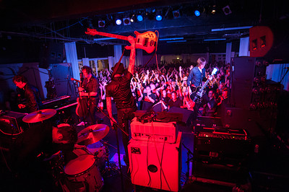
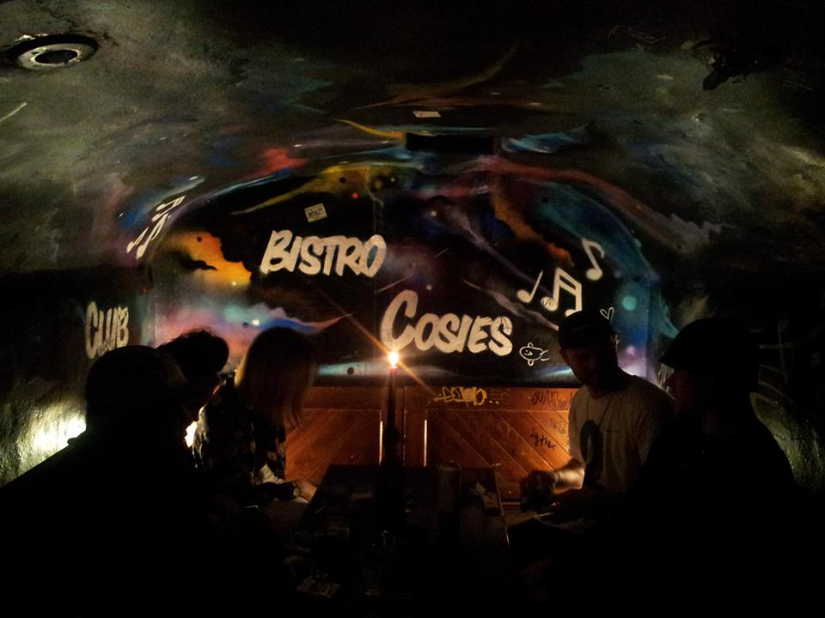
Setting - Venues
Trinity Centre – Hip-hop
Colston Hall - Punk
Cosies - Reggae
Lakota – Rave Music
Notes:
Mike
Looked into popular venues that were/are important in underground music in Bristol.
e.g. Lakota has been open 20 years and was very prevalent in the 90s rave scene in Bristol
Planning to 3D model these venues and put them into our scenes.
Already in touch with the trinity centre to go in and take photos for reference.
Attempting to get in touch with lakota

Slide 7

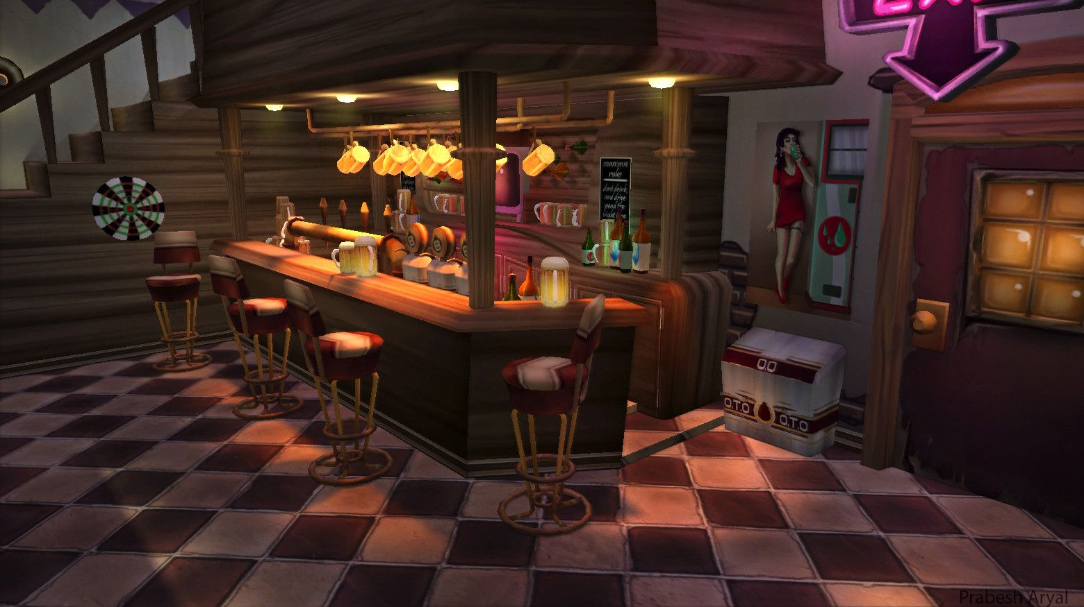
Visual Style
Minimal Art Style
Ethereal based characters
Low detail environments
Notes:
Eddie
-Art Style
The art style for the experience will be quite minima​l, with textures being quite simplistic. Generally smooth simplistic colours rather than detailed textures.
- Characters
Characters will be ghostly ethereal shapes rather than 3D models. They will consist of particle systems in the shape humanoid characters.
-Low Poly Environments
The venue environments will be quite simplistic models with a relatively low polygon count, this is far easier to make it aesthetically pleasing than attempting to create highly detailed environments.

Slide 8
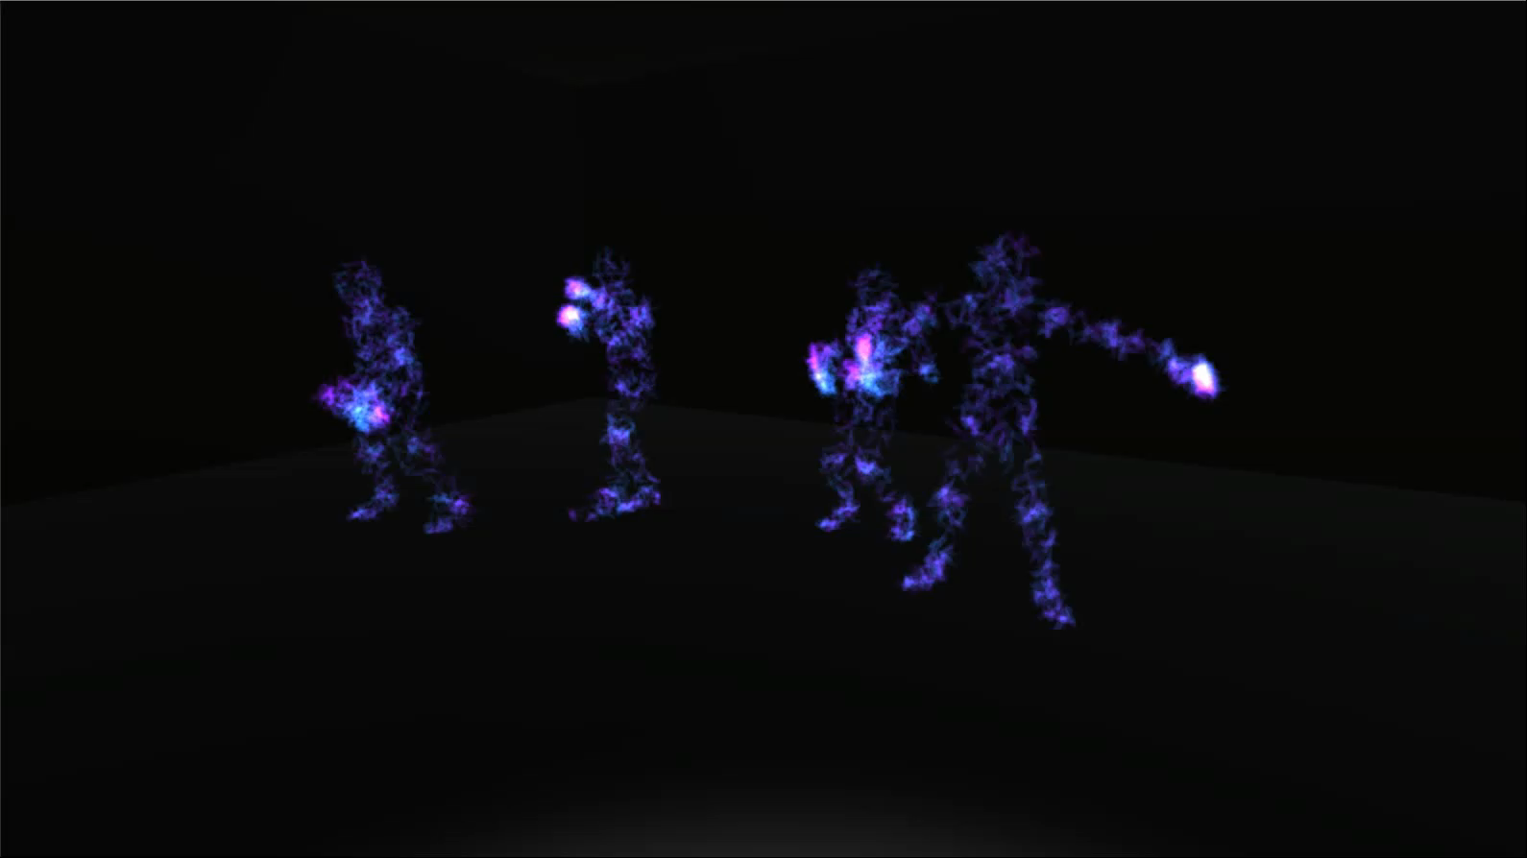
Prototype

Slide 9
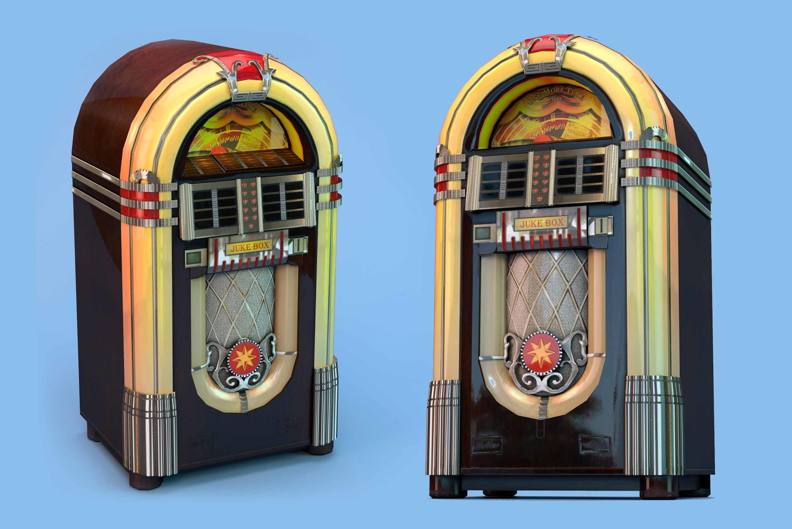
Interactivity
Minimal interaction
Lobby scene
Primarily linear, with flavour interaction
Notes:
Harry
Interacttion with Jukebox to choose venue/Music
Lobby scene
Flavour interaction – Pick up items such as drinks etc.

Slide 10
Research
Bristol music archive
Bristol Uni CHOMBEC
Limina research on target audience
Seven decades of sound
Viewing venues for reference
Notes:
Mike
- As its quite a specific thing we’re covering we want to make it as accurate as possible – heavily researched
As mentioned, in touch with Trinity
Looked into the Limina/catapult report about their content formats – seen in our GDD
Using Bristol uni’s archive to find research about our genres
7Dec is a project encompassing Bristol’s music history, lots of relevant info
-Centre for history of music in Britain, the empire and the commonweath

Slide 11
User Research - Interviews
Questions related to their experiences
Direct recording of interviews
Voiced retelling of recordings
Notes:
Pearce
- Revisualising testimony

Slide 12
Questions?

